Slide 1



NAMED ENTITY RECOGNITION
Automatic Detection of Chemical Disease Relations (CDR Corpus) )
MSc in Data Analytics
Professor – Devesh Jawla
CA-01
Presented by-
Aryant , Himanshu, Mamatha, Vinay

Slide 2
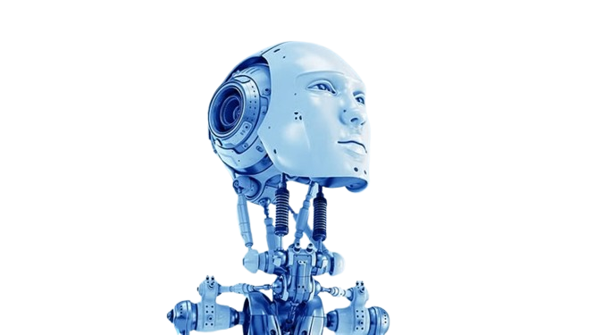
Points Of Interest
Introduction
Aims & Objectives
Literature
Review
Methodology
Observations
Challenges
Conclusion
Results
Future Work
Presentation Title

Slide 3
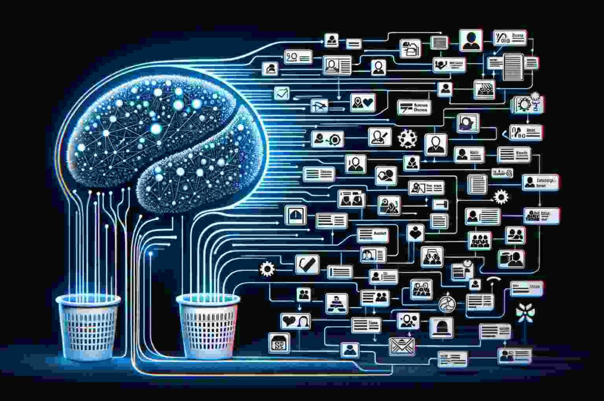
Introduction
What is Named Entity Recognition (NER)?
- Identifies and categorizes named entities in text.
- Focus on Chemical-Disease Relations (CDR) from biomedical texts.
- Uses spaCy with Active Learning to reduce annotation efforts.

Slide 4

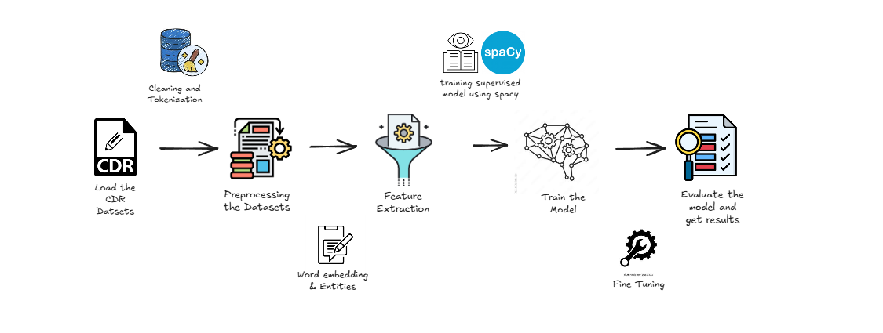
Supervised Learning
Supervised ML-based systems use ML models trained on texts humans have prelabeled with named entity categories. Supervised machine learning approaches use algorithms such as conditional random fields and maximum entropy, two complex statistical language models.
- Uses labeled data (HMM, SVM, MaxEnt Models).
- High accuracy but needs manual annotation.

Slide 5
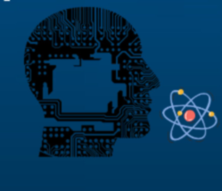
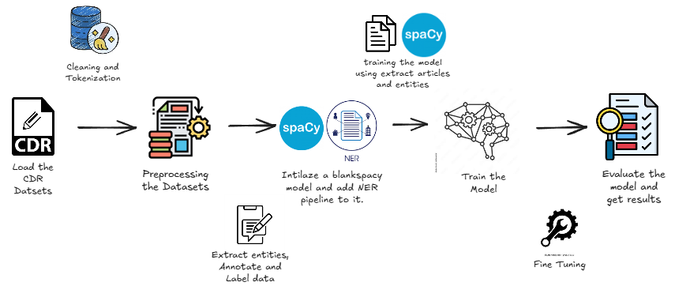
Unsupervised Learning
Unsupervised learning in artificial intelligence is a type of machine learning that learns from data without human supervision. Unlike supervised learning, unsupervised machine learning models are given unlabeled data and allowed to discover patterns and insights without any explicit guidance or instruction.
- Works with unlabeled data (Clustering, Associations).
- Reduces annotation cost but needs post-processing.

Slide 6

Aims & Objectives
Aim:
- Implement NER using spaCy on the CDR dataset.
- Enhance performance using Active Learning.
Objectives:
- Train an Active Learning-based NER model.
- Reduce manual annotation workload.
- Optimize training using uncertainty sampling.

Slide 7
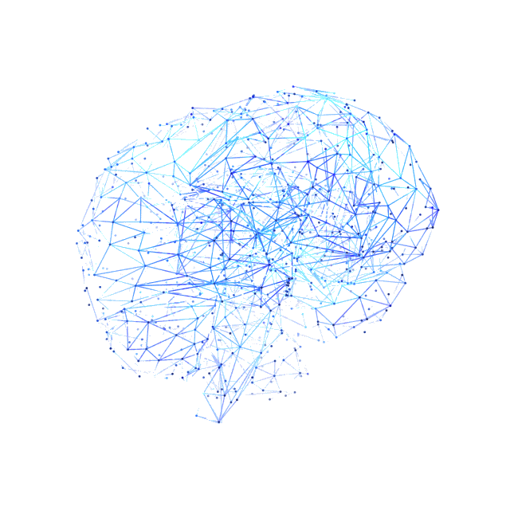
Literature Review
Natural Language Processing (NLP):
- Enables computers to understand/process human language.
- Applications: Chatbots, search engines, biomedical text mining.
Active Learning for NER:
- Uncertainty Sampling: Model selects least confident predictions. - Query-by-Committee: Multiple models vote on uncertain cases.
Preliminary research : -We analyzed active learning for biomedical entity recognition, focusing on Annotation cost efficiency, Selecting the most informative instances for labeling -PubTator (NCBI tool): Extracts biomedical named entities from PubMed/PMC, including: Genes/Proteins, Diseases, Chemicals/Drugs, Mutations, Species

Slide 8




State-Of-The-Art
BioBERT
SpaCy
PubMedBERT
Prodigy
- BioBERT: High accuracy, needs large datasets.
- spaCy: Lightweight, supports Active Learning.
- PubMedBERT: highly specialized for biomedical text.
- Prodigy: AI-assisted annotation tool.
Why spaCy?
- Lightweight & fast processing
- Customizable NLP pipelines
- Supports Active Learning
Few More examples are there :-
BlueBERT(Clinical & Biomedical BERT)
BioMegatron(Transformer with Large-Scale Biomedical Pretraining)
ClinicalBERT(BERT for Electronic Health Records - EHR)

Slide 9
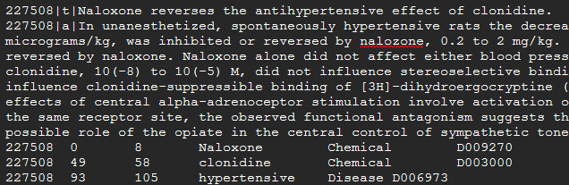
Methodology
1. Loading the required Libraries:-
- spaCy, Random, re , Pandas, NumPy, Matplotlib ,Seaborn & Warnings
2. Load the Datasets and Preprocess the DATA:-
- Dataset Used:
- Bio_Creative V CDR Corpus (Chemical-Disease Relations).
Files:-
- CDR_TrainingSet.PubTator.txt
- CDR_DevelopmentSet.Pubtator.txt
- CDR_TestSet.PubTator.txt
A Sample of PubTator Document

Slide 10
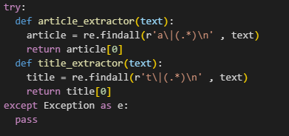
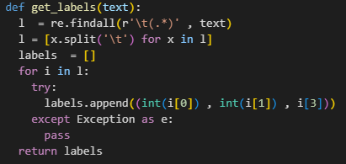
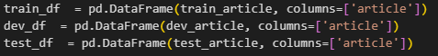
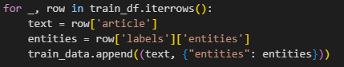
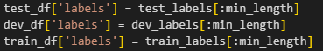
Methodology
3. Pre-processing Steps:-
- Extract title, text, annotations from PubTator format.
- Convert to spaCy-compatible format.
Extraction of Titles & Articles
Extraction of Labels
Converting the dataframe into SpaCy Format
Adding extracted text & entity labels to a dataframe

Slide 11
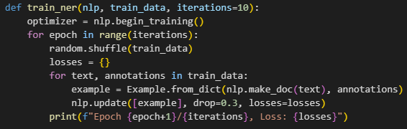
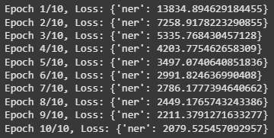
Methodology
4. Model Development:-
❖ Initializing a blank English SpaCy model and initializing the NER pipeline.
❖ Adding two labels for categorizing from the dataset Chemical and Disease.
❖ The iterative process of Active Learning will start: -
− Start training the model on Train & Dev dataset in multiple Epochs/Iterations.
− Labeled data applied to model for label prediction.
− Identifying predictions with low confidence(Uncertain Predictions).
− Ignoring the lines from Training & Development datasets if entity misalignments are found.
− Hyperparameter Tuning to increase the model accuracy.(Epochs, Batches, Dropout Rate)
Model Training Phase
Losses per Training Cycle

Slide 12
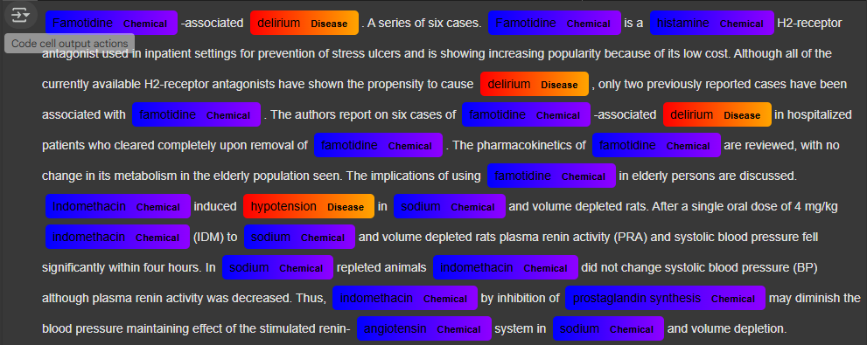
Methodology
5. Model Evaluation:-
In this phase trained model will be used to test the unlabeled and unseen data(Test set).
For computing the performance of the model, evaluation metrics are calculated.
Key Evaluation Metrics for Model Performance
Precision (Positive Predictive Value) – Measures how many predicted positives are correct.
Recall (Sensitivity/True Positive Rate) – Measures how many actual positives are correctly predicted.
F1-score – Harmonic mean of Precision and Recall, balancing both.
Confusion Matrix – Summarizes model performance using TP, FP, FN, and TN, mainly for classification models.

Slide 13
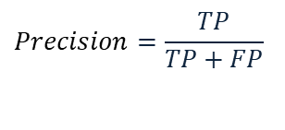
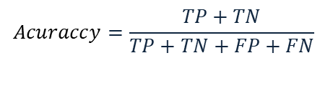
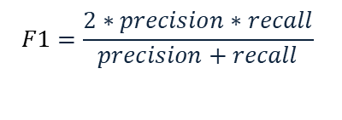
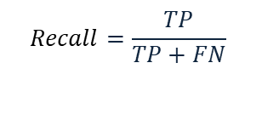
Evaluation Results
81.23%
74.56%
77.75%
95.72%
Precision
Recall
F1 - Score
Accuracy
$$Precision=\frac{TP}{TP+FP}$$
$$Recall=\frac{TP}{TP+FN}$$
$$F1=\frac{2∗precision∗recall}{precision+recall}$$
$$Acuraccy=\frac{TP+TN}{TP+TN+FP+FN}$$

Slide 14
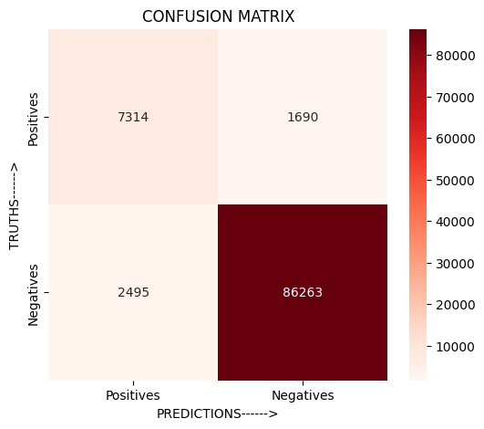
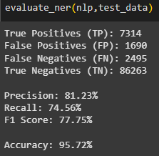
Results & Confusion Matrix
Evaluation Results
Confusion Matrix

Slide 15

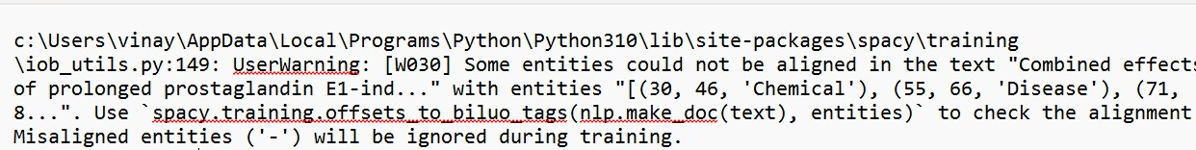
Observations & Challenges
Crucial Observations:
- Active Learning refines NER models.
- More annotated data improves reliability.
- The recognition of Chemical entities is easier compared to the Diseases entities.
- The model successfully adapted to complex biomedical terminology using limited data through active learning.
Key Challenges:
- Overlapping Entities: Confusion in similar labels.
- Incorrect Entity Boundaries: Misalignment of entities in the CDR_Datasets.
- Misclassifications: Wrong category assignment.
A SpaCy warning for
Entity Offsets

Slide 16


Conclusion & Future Work
- Demonstrates less annotation burden while maintaining the high NER performance.
- Validates active learning’s applicability in the biomedical domains.
- The Active Learning is better option than Supervised Learning for detection of Chemical-Disease Relations Entities.
Future Work:
- Explore Deep Learning models (BioBERT).
- Implement real-time annotator feedback(Prodigy).
- Improve handling of entity offsets & misalignment. (SpaCy BILOU tags)

Slide 17
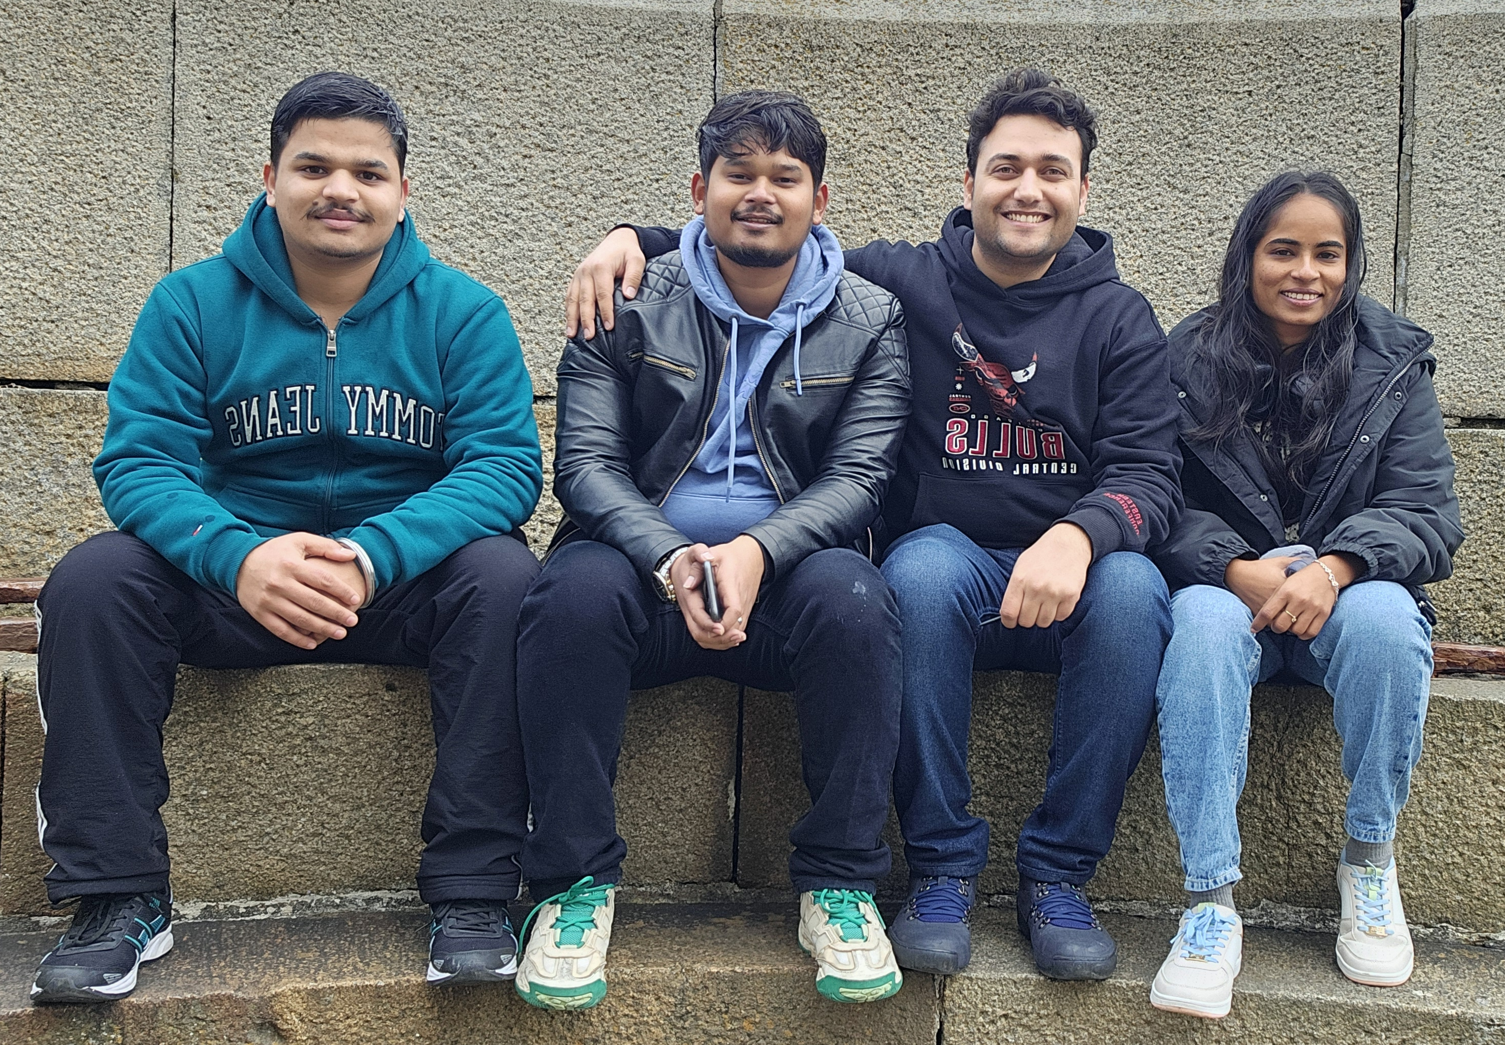



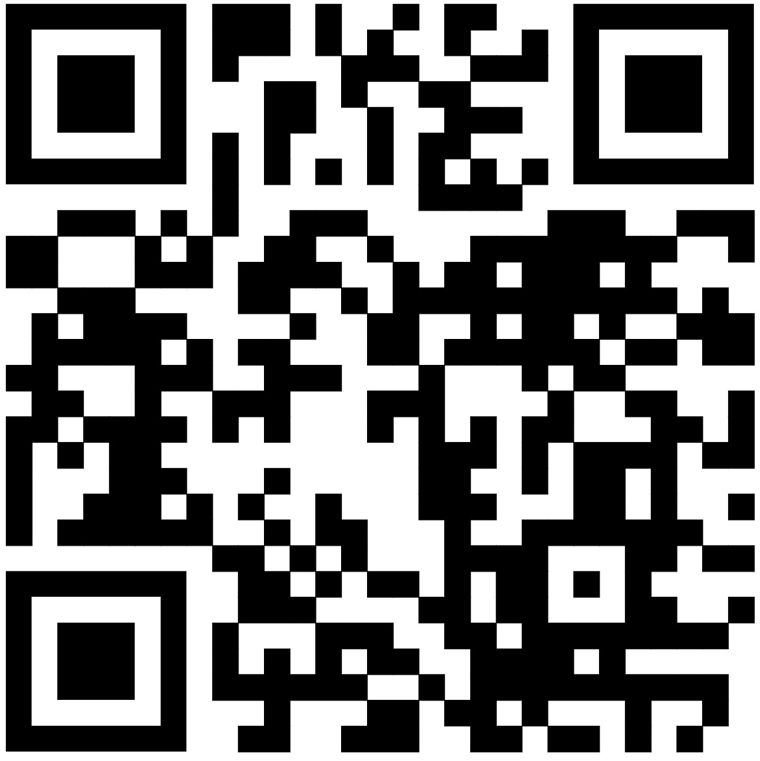

THANK YOU
Best of Luck to other Groups
Scan this QR to get to the Git Repo
Happy Coding …..

